Slide 1
Case Study:
Comb pattern in Honeybees
CITS4403 Computational Modelling

Slide 2
Biological patterns
- Constructed via a combination of mechanisms including self- organization, hypothesis and templates
Self-organization: integrate biological subunits into a coherently functioning entity
- Pattern formation on honeybee combs is dependent on self-organization and at least two templates hypothesis

Slide 3
Templates
Two templates:
Gravity based template:
Honey always above and never below the brood
Queen based template:
Pollen foragers always upload pollen near brood to satisfy the need of feeding the queen

Slide 4
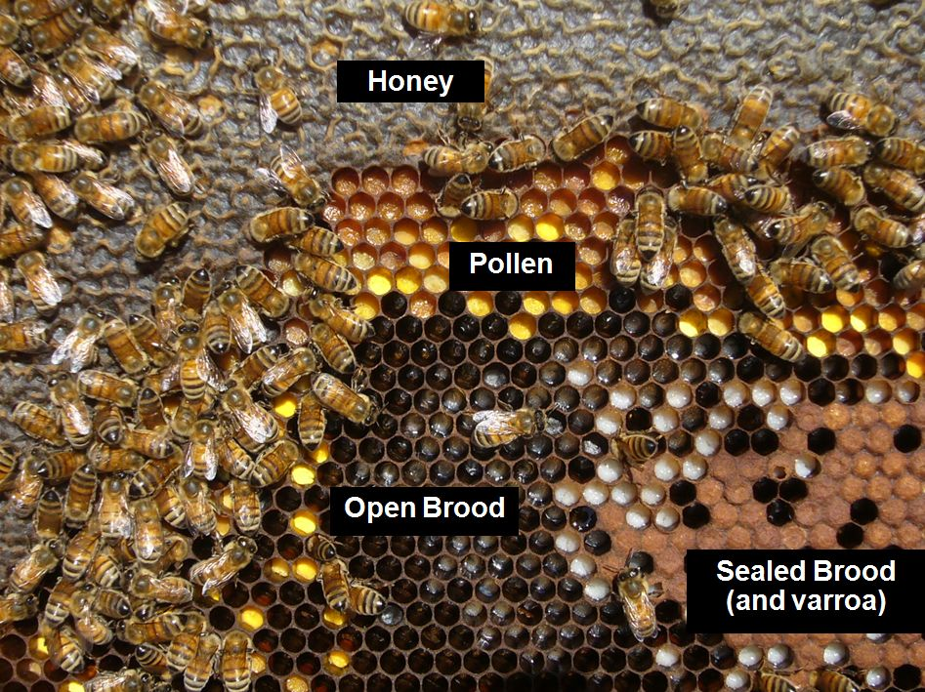
Pattern formation
A typical honeybee comb, consisting of three distinct, concentric regions: a central brood area, a surrounding band of pollen, and a large peripheral region of honey

Slide 5
Three rules
Three basic rules to explain the pattern of comb usage in honey bees:
The queen lays egg in the centre of the comb
Workers deposit pollen and nectar at random
Bees preferentially remove pollen and nectar from the brood nest relative to the honey storage area

Slide 6
Model Overview
Nest: Long and narrow, 64*40 cells, only contains one material at one time
Cell: Hexagon
Bees: 3 types included
1. Queen: begin by filling up most of the cells in the center of the nest
2. Pollen forager: unload pollen near open brood to increase the efficiency of nurse bees
3. Nectar receiver: walk upwards until they find an empty cell to upload, fill up surrounding cells from top to bottom

Slide 7
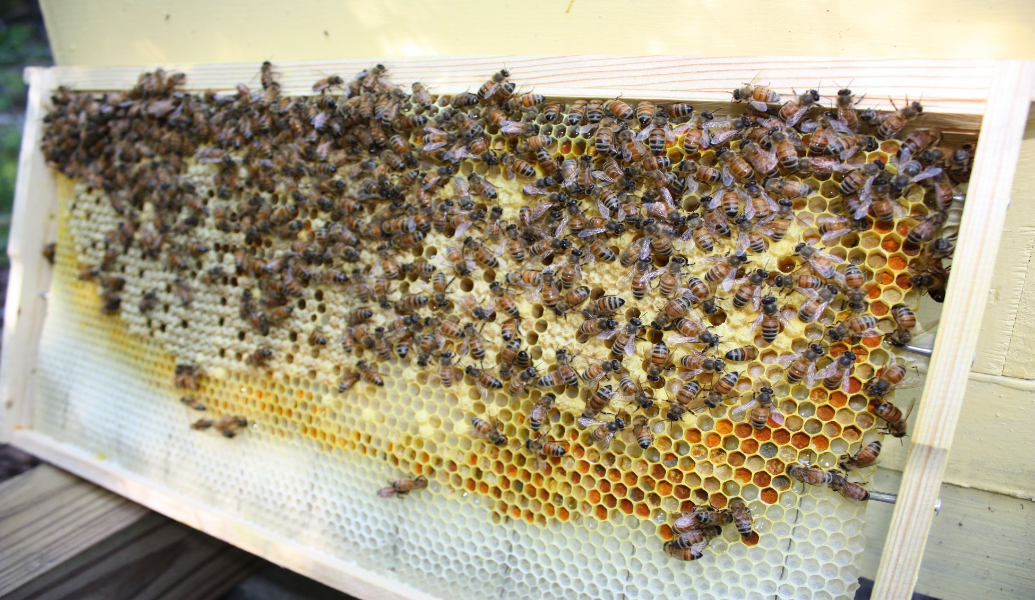
Algorithm Analysis
Brood Cells pollen cells will be filled inside out

Slide 8
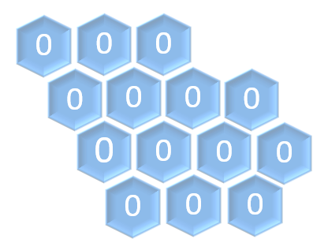
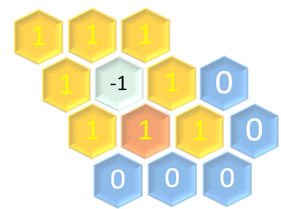
Algorithm Analysis
Brood Cells Empty = 0,Brood = -1, Pollen = -2, Honey = -3
points = np.zeros((row, column), dtype=int)
maxWeightList = np.where(points == weight)

Slide 9
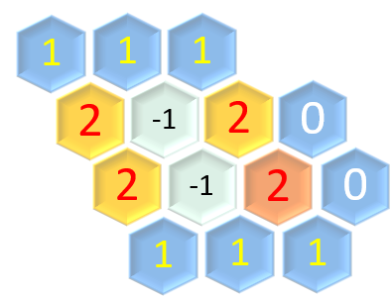
Algorithm Analysis
Brood Cells

Slide 10
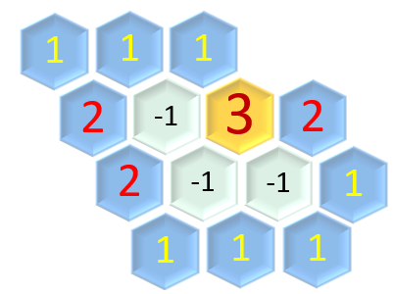
Algorithm Analysis
Brood Cells

Slide 11
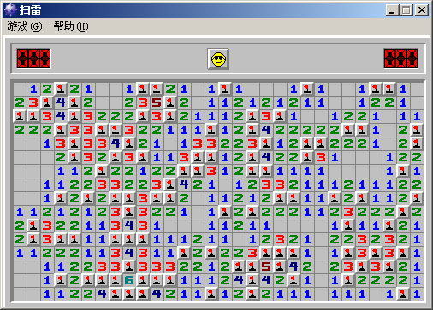
Algorithm Analysis
Brood Cells

Slide 12
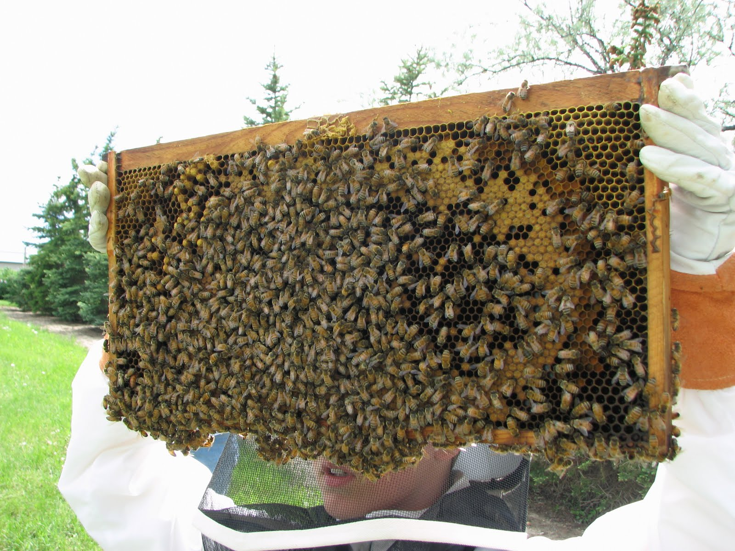
Algorithm Analysis
Pollen Cells top -> bottom

Slide 13
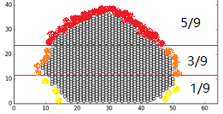
Algorithm Analysis
Pollen Cells

Slide 14
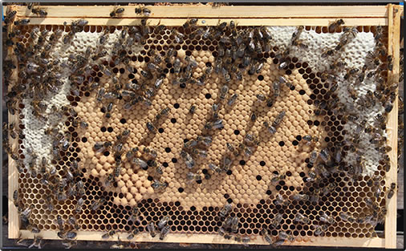
Algorithm Analysis
Honey Cells up -> bottom

Slide 15
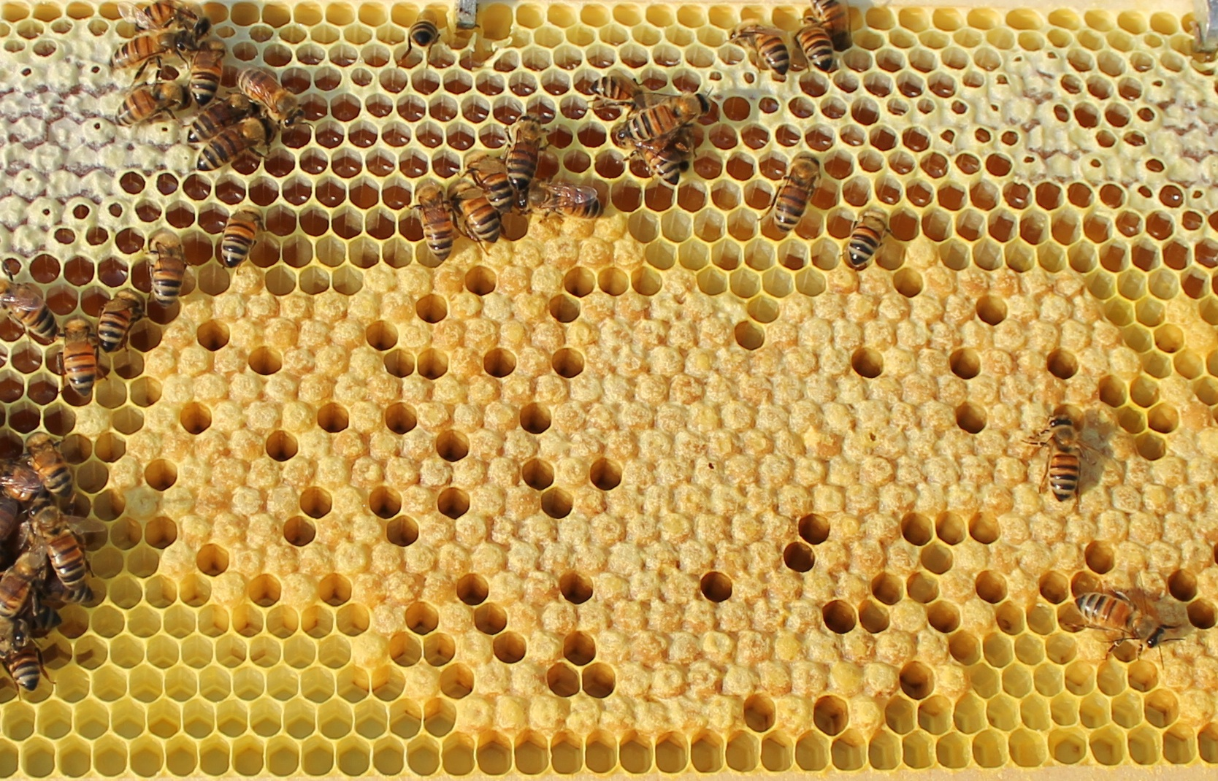
Algorithm Analysis
Honey Cells Cells between honey and brood will not be filled

Slide 16
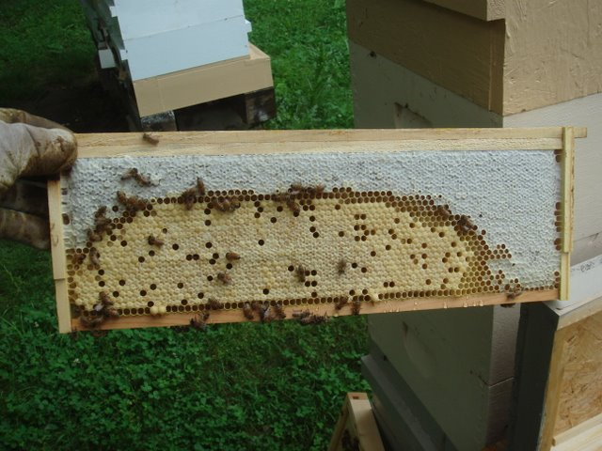
Algorithm Analysis
Honey Cells

Slide 17
Further improvement
- Formation speed: “queen bias ” and the difference of pollen rate during daytime
- Weather Factor: foragers did not forage in rainy days and rain leads to the loss of pollen stores
Random consumption of pollen and honey by workers and queen was not considered in this imitation
It only considers the pattern formation before young bees start to vacate their cells (the first 20 days).

